Slide 1
Exploration and Implementation of MapReduce
Presenters:
Zifan WANG
Yazhou SHEN
Notes:
Our project contains two parts: paper review and our own implementation

Slide 2
Background
Large Volume of Data
Limited Computation Power on Single Machine
Hardware Failure
Difficulty in Distribution and Parallelization
Notes:
We are currently in an era of information explosion. Large volume data are generated every day by social media, etc. Traditional computing systems may struggle to handle the sheer volume of data
And it will be more and more difficult to increase the computation power of a single machine. We are currently using 3nm chips but we can't keep decreasing the semiconductor size due to physical limits. And it is also impossible for a machine to store all the data we need for the computation. Therefore, we need a large number of machine coordinate together to finish the same task.
But when we use multiple machines hardware failures are inevitable in large-scale clusters. Even though the probability of a node failure is low, but we need thousands of machines. We will always meet some hardware problem.
And it is difficult for every to write a distributed, parallel, and fault-tolerant code. People need a well-designed computation framework to fill this gap. Therefore, we have MapReduce.

Slide 3
Solution: MapReduce
Scalability: Large Volume of Data
Parallel Processing: Limited Computation Power on Single Machine
Fault Tolerance: Hardware Failure
Simple to Implement: Difficulty in Distribution and Parallelization
Notes:
MapReduce enables horizontal scalability, distributing data and processing across multiple nodes in a cluster. As data grows, you can add more nodes to the cluster, ensuring efficient scalability.
MapReduce divides tasks into smaller sub-tasks that can be processed in parallel. This parallel processing significantly accelerates data processing and analysis.
MapReduce provides built-in fault tolerance. If a node fails during processing, the system redistributes the task to other available nodes, ensuring continuous operation without data loss.
MapReduce abstracts the complexities of distributed computing, allowing developers to focus on writing code for the specific tasks they want to perform. This abstraction simplifies the development process.

Slide 4
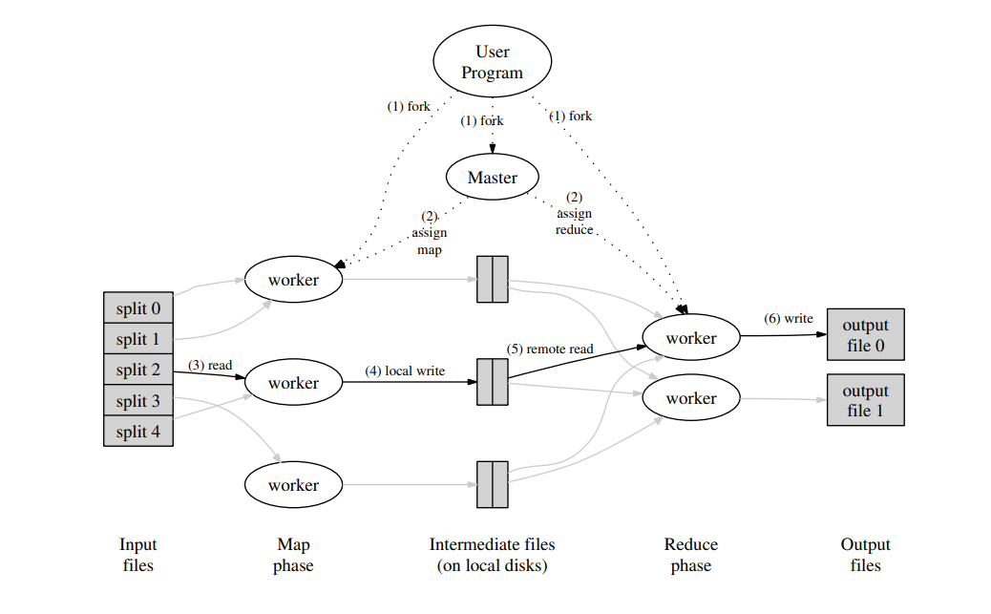

MapReduce Structure
$m_{i}$
Notes:
This is the overall structure of MapReduce which I will introduce later. We can see it is not so complicate and even kind of simple.
It really amazing to hear that it can handle almost all the computation task in google ten years earlier. It basically contain three parts: Map phase, reduce phase, and the shuffle phase(how to deal the intermediate files)Before I dig deeper into the structure. I am going to talk about the input and output of MapReduce.

Slide 5

Input and Output
MapReduce model working on <Key, Value> pairs
Example: word count
Input:
<document name, document content>
Document content: I love to learn parallel computing. I love it too.
Output:
I 2, love 2,to 1, learn 1, parallel 1, computing , too 1.

Slide 6
MapReduce Structure
Split and copy
Work assignment
Map and store in buffer
Written to local disk and partitioned into R regions
Reducer fetch result
Reduce data and output
Pass output to user

Slide 7


Correctness of MapReduce
The Deterministic MapReduce Class(DMRC)
Machine number:
Memory Limit of one machine:
Total space:
To be prove: shuffle step can place all of the values associated with a key on one machine without violating the memory constraints.

Slide 8
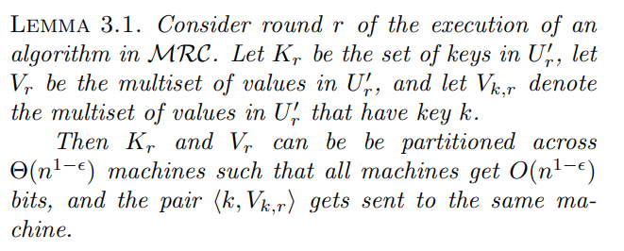
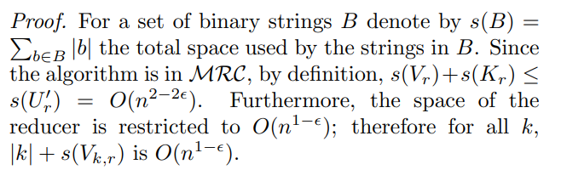
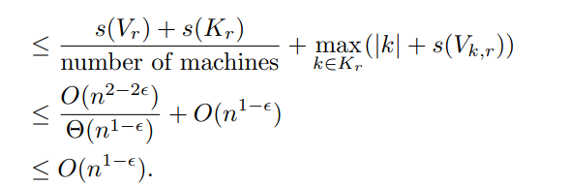

Slide 9
Future Work in Paper review
Kepp working on paper review and gain deeper understanding of DMRC class and relation between MRC/DMRC/NC/P
Evaluate different complicate algorithm in MapReduce: find MST and try to abstract the design process of MapReduce algorithm

Slide 10
Implementation
Our goal is to build a MapReduce framework.
The framework consists a master server and multiple worker machines.
The users define their own Map/Reduce functions and upload them to the server.
The server will send the programs and data to each client.
Our framework is intended to be easy to deploy.

Slide 11
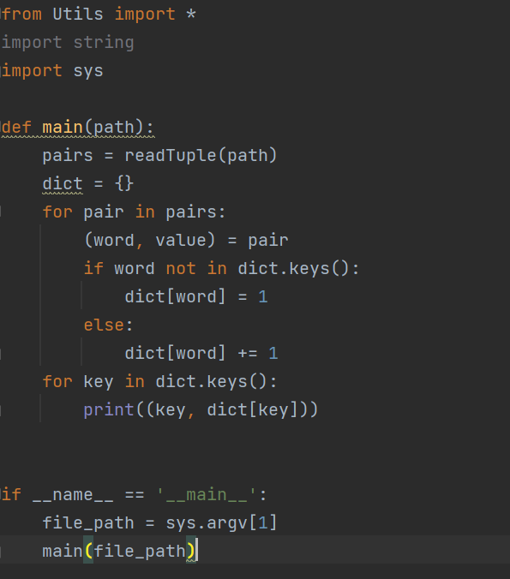
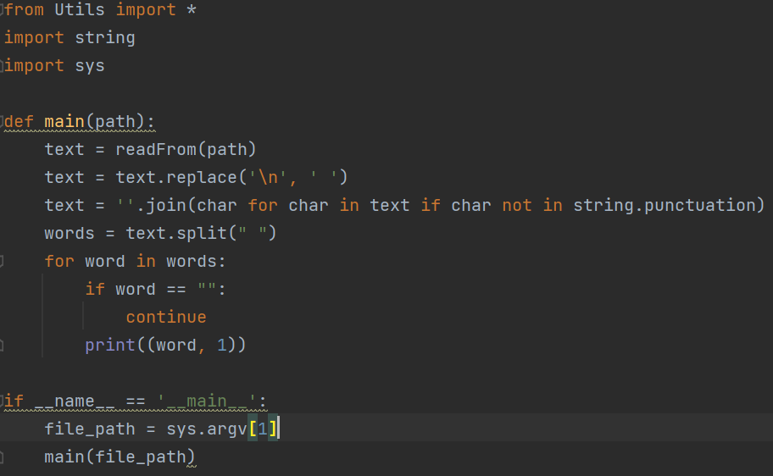
Implementation
(Core components) Map and Reduce
Customizable: Users can define their Map and Reduce functions as they wish, they can write whatever they want in mapper.py / reducer.py.

Slide 12
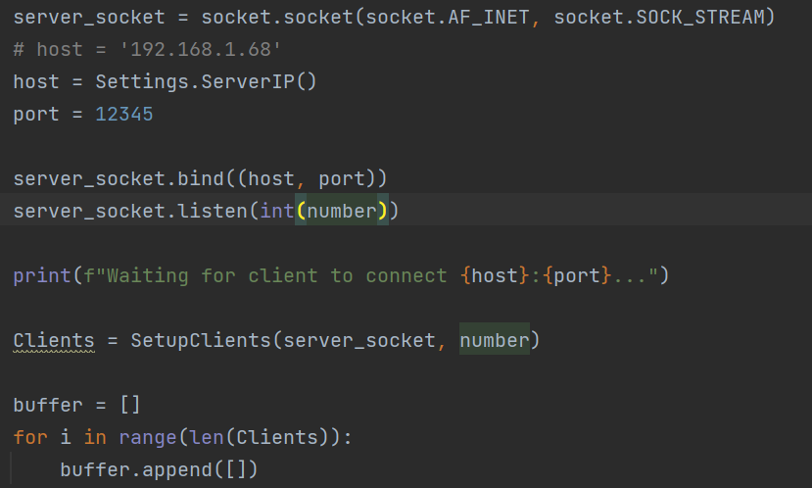
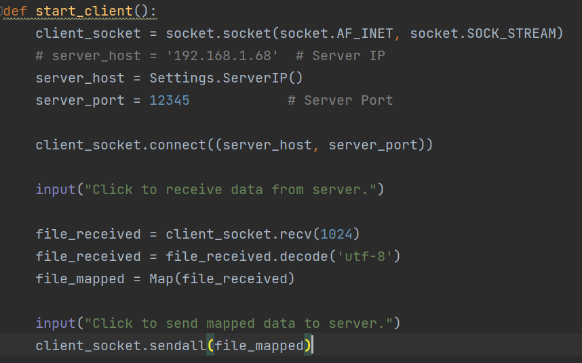
Implementation
Communication: Socket

Slide 13
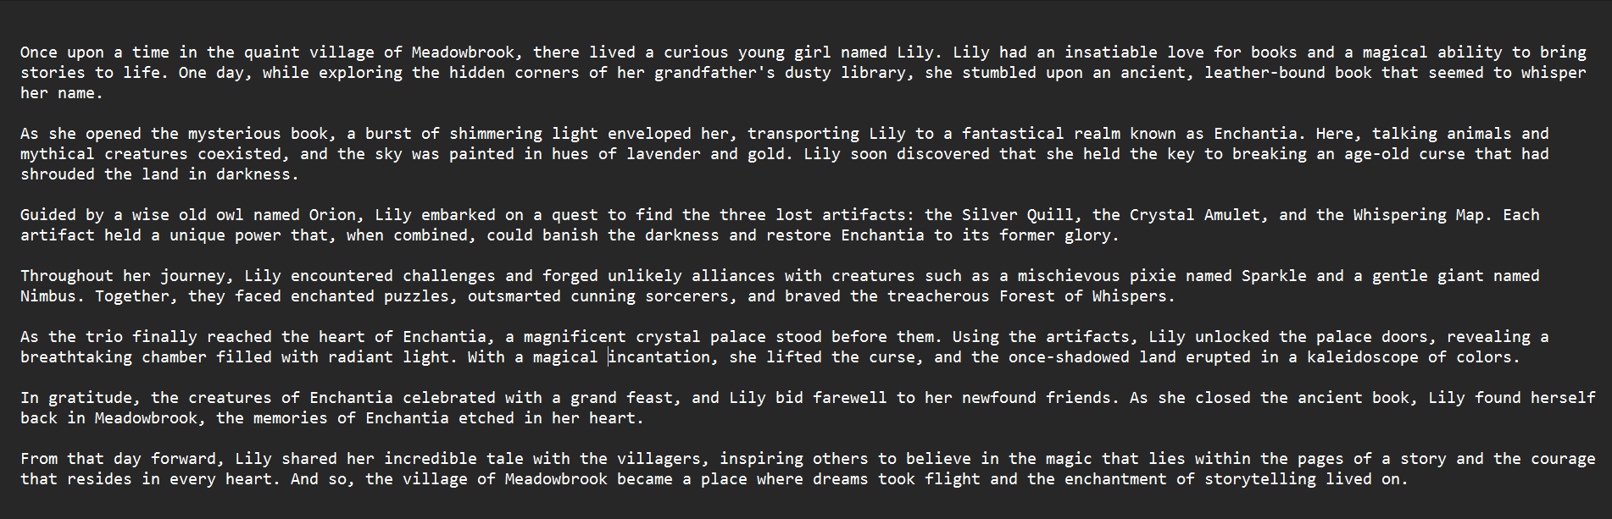
Implementation

Slide 14
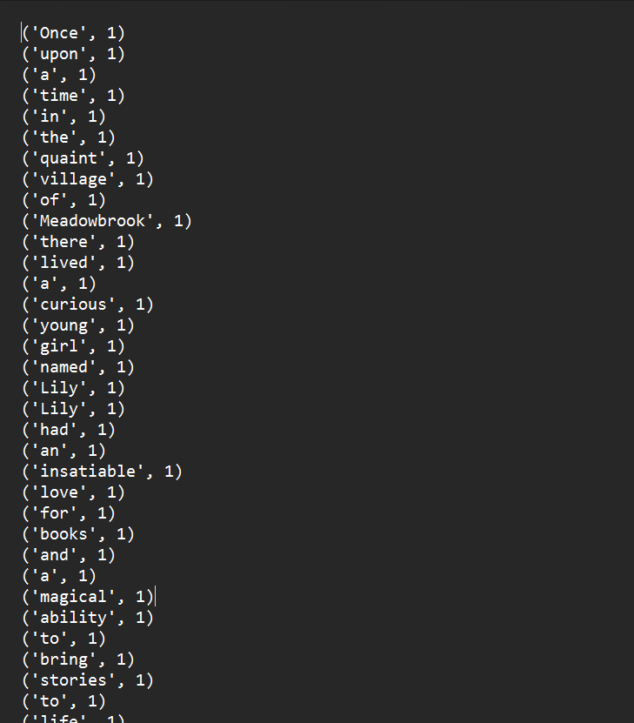
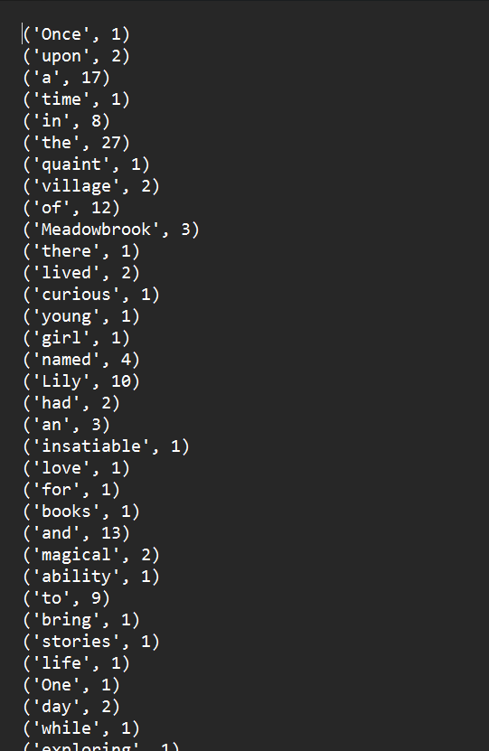
Implementation

Slide 15
Implementation
Distributed File System
Fault-Tolerance: If a client dies, its work will be assigned to other idle clients. If a master dies, the server will be reboot based on the latest log.
Process of the last few tasks: The works of the stragglers will be assigned to other idle clients.
(Straggler: when all other machines finish their works, the machines that are still running are called stragglers, because we have to wait for their completion.)

Slide 16
Implementation
Experiment:
Implement some other algorithms
Run on more machines and plot the results

Slide 17
Analysis on the Parallelism
We use the the example of word counting.
We have a text of N words (N is large). There are a total of K different words.
N >> K > P.

Slide 18
Analysis on the Parallelism
If we do this sequentially, the time complexity will be T(N) = N * T_count(1).
T_count(x) has an average of O(1).
T(N) = O(N)

Slide 19
Analysis on the Parallelism
With MapReduce running on P machines, we expect it to have:
T(N) = T_setup(P) + T_split(N, P) + T_map(N / P) + T_shuffle(N) + T_reduce(N, P) + T_combine(P)
T_setup(P) = O(P)
T_split(N, P) = O(N)
T_map(N / P) = O(N / P)
T_shuffle(N) = O(NlogN)
T_reduce(N, P) has an average of O(N / P)
T_combine(P) = O(P)

Slide 20
Analysis on the Parallelism
T(N) = O(NlogN)
We will still try to find solutions for this bottleneck, or find a better approach to implement the functions.

Slide 21
Future Work
Keep working on our framework
Complete the DFS
Solve the bottleneck in shuffle
Do some tests and experiments to evaluate our framework
Try to make it a simple library for testing MapReduce
Keep working on our analysis on parallelism of the framework, and solve the problem

Slide 22
Conclusion
MapReduce is a parallel computing model, and is conceptually simple.
Many algorithms can be written in parallel forms following the MapReduce model, including complicated algorithms.
We are trying to build a MapReduce framework that is easy to deploy.
We are trying to analyze the parallelism of our framework on different algorithms.

Slide 23
Q & A
Thank you!

